Slide 1
T³ Investigators
Chief Investigators
Prof S Middleton
Prof C Levi
Prof M Fitzgerald
Prof J Considine
Prof J Grimshaw
Prof C D’Este
Prof R Gerraty
Prof W Cheung
A/Prof D Cadilhac
A/Prof E McInnes
Associate Investigators
Mr G Cadigan
Ms S Dale
Ms S Denisenko
Mr M Longworth
Prof P McElduff
Ms C Quinn
Prof J Ward

Slide 2
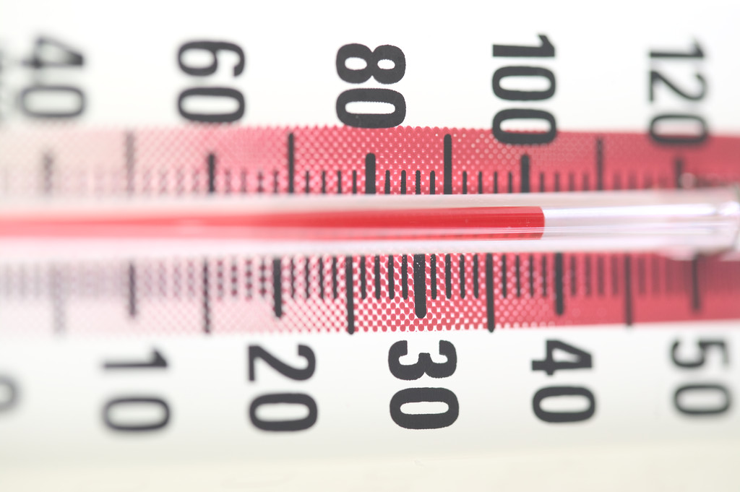
Background
In the first days of an acute stroke:
Up to
68% become hyperglycaemic²
> 37.5°C in
20-50% patients¹
37- 78% experience dysphagia³
All result in increased morbidity and mortality and enlarged infarct size
¹ Azzimondi et al. Stroke.1995
² Scott et al. Stroke. 1999
³ Martino et al. Stroke. 2005
Notes:
These first couple of slides are really background to why we did the QASC trial

Slide 3
Mechanism
Fever:
Increased cerebral metabolic demands
Changes in the blood-brain barrier permeability
Acidosis
Increased release of excitatory amino acids
Hyperglycaemia:
Toxic to the brain
Insulin deficiency
Blood brain barrier disruption
Den Hertog HM, et al. 2011. Clement et al. 2004

Slide 4
Mechanism
Swallowing ability:
Aspiration can lead to:
chest infections
aspiration pneumonia
death
Martino et al 2005

Slide 5
Background: QASC Trial
Intervention:
- Three clinical protocols (Fess Protocols) to manage
Fever
Hyperglycaemia (Sugar)
Swallowing dysfunction
- Implementation Strategy: barriers & enablers workshops; interactive education; reminders (site support, email and phone contact)
FeSS protocols
Notes:
We know that only distributing protocols do not change clinical practice
But we know that protocols alone don’t work, and so, apart from the protocols there was an implementation strategy that was a key component of the trial.

Slide 6
Background: QASC Trial
15.7 % more likely to be alive and independent 90 days post-stroke (p=0.002; mRS)
Temperature (p=0.001)
In first 72 hours of stroke unit admission, lower mean of:
Blood glucose (p=0.02)
Within 24 hours of stroke unit admission:
Improved swallow screening (p=<0.001)
Decreased length of stay by two days (13.7 days vs 11.3 days; p>0.144)
Notes:
So its clear that these results have a large implications for clinical practice
So, these results are better than any other intervention
And so.. All of our patients should be getting this

Slide 7
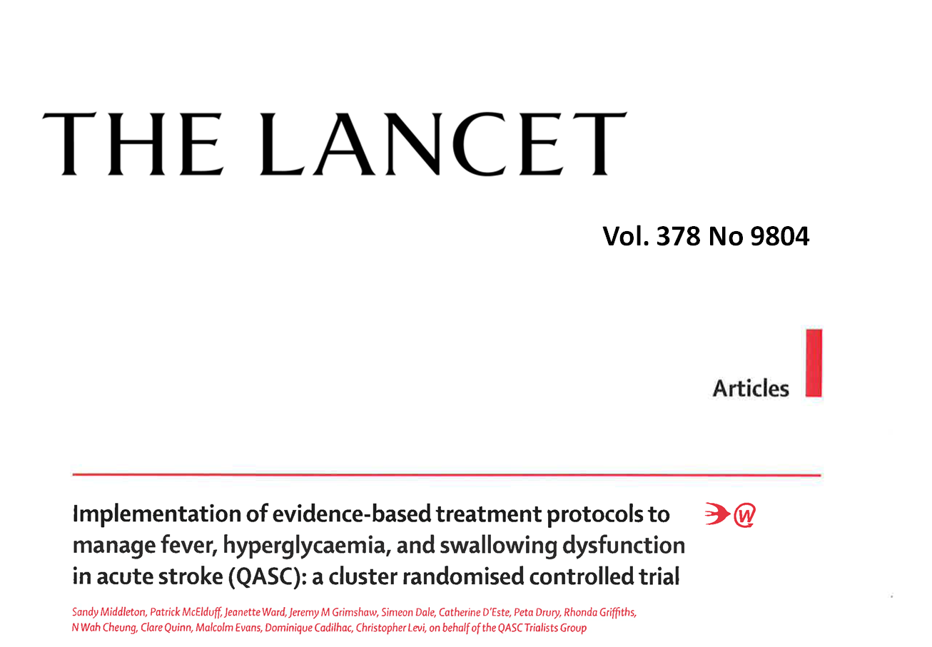
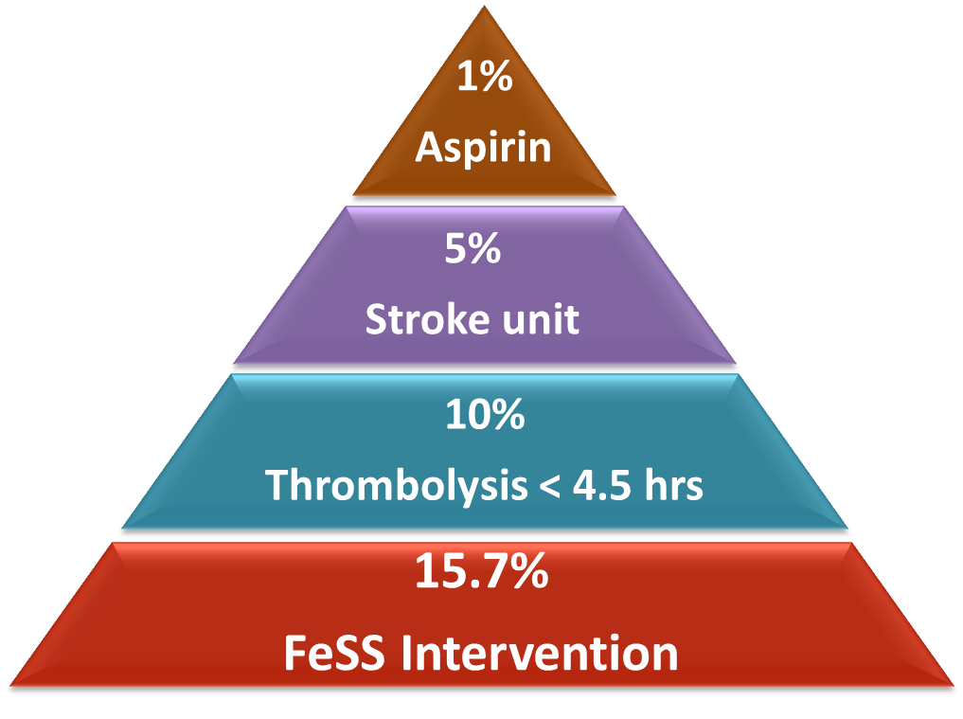
Vol. 378 (9804), 2011
Middleton S, McElduff P, Ward J, Grimshaw JM et al. Implementation of evidence-based treatment protocols to manage fever, hyperglycaemia, and swallowing dysfunction in acute stroke (QASC): a cluster randomised controlled trial. The Lancet 2011; 378(9804): 1699-1706

Slide 8
Background
Clinical guidelines currently recommend early management of the stroke patient in the Emergency Department
TRANSFER
TRIAGE
TREATMENT
Clinical Guidelines for Stroke Management 2010

Slide 9
Background - Triage
Triage times of < 10 mins (ATS Cat 1 or 2) recommended for patients with stroke signs/ symptoms
< 13% of stroke patients triaged to Cat 2
62% triaged to Cat 3 (seen in < 30 mins)
25% were triaged Cat 4 (seen in < 1 hour)
TRANSFER
TRIAGE
30% were not allocated an urgent triage category (1 or 2)
TREATMENT
Considine & McGillivray. Journal of Clinical Nursing. 2010, Mosley et al. Australasian Emergency Nursing Journal. 2013
Notes:
First couple of dot points are quite old data now, and from one site
Last dot point is data from Ian Mosley:
798 patients were included in the study. Among acute stroke patients who presented within 2 h (n = 185), 173 (94%) were identified as stroke at triage with 10 cases identified as ‘‘altered conscious state’’. In all cases not identified as stroke the patient was diagnosed with intracerebral haemorrhage. 132 cases (71%) were allocated a triage category 1 or 2. Facial weakness (p = 0.002) and presentation to Monash Medical Centre (p = <0.001), were significantly associated with triage category 1 or 2.

Slide 10
Background – Treatment (tPA)
Only 45% of ischaemic stroke patients presenting to hospital within 3 hrs of stroke were assessed for eligibility for rt-PA (2013)
Currently, only 7% of ischaemic stroke patients in Australia receive thrombolytic therapy
TRANSFER
TRIAGE
TREATMENT
National Stroke Foundation. 2013
Notes:
These slides are data from the most recent NSF data

Slide 11
Background – Treatment (FeSS)
Fever: 60% received regular monitoring in first 72 hrs of admission
Only 36% with fever (>37.5 C) received paracetamol within 1 hour
Glucose: 21% received regular monitoring in first 72 hrs of admission
Only 25% patients with hyperglycaemia (>10mmol/L), received insulin within 1 hour
TRANSFER
TRIAGE
TREATMENT
National Stroke Foundation. 2013

Slide 12
Background - Treatment (FeSS)
Swallowing: 66% of patients received screen/ assessment within 24 hours of admission
Only 52% received a swallow screen/ assessment prior to oral intake
QASC: 22% given oral fluid or food before screen
QASC: 34% given oral medications (? Aspirin)
TRANSFER
TRIAGE
TREATMENT
National Stroke Foundation. 2013

Slide 13
Background - Transfer
QASC trial showed a median ED LOS 7 hrs (max 20 hrs)
ED LOS of 11 hrs (20% >20 hrs)*
Median transfer time from ED to stroke unit of 8 hours
TRANSFER
TRIAGE
TREATMENT
*Considine & McGillivray Australasian emergency nursing journal. 2009
Notes:
This data is from before the NEAT targets

Slide 14
Aim
To develop, implement and evaluate the impact on death and dependency, functional dependency and quality of care, of a multidisciplinary organisational intervention to improve the Triage, Treatment and Transfer of stroke patients in Emergency Departments (ED)

Slide 15
Significance
One of the few large multisite trials internationally led by nurses
Whilst it requires multidisciplinary support (Physicians, Speech pathologists) it is primarily about good evidence-based nursing care
Will provide evidence that what ED nurses do makes a difference to patient outcomes

Slide 16
Intervention
Care Element
Triage:
All patients presenting with signs and symptoms of suspected stroke should be triaged at Australian Triage Scale Category 1 or 2 (seen within 10 mins)
Notes:
Initial clinical assessment is the cornerstone of diagnosis for stroke however diagnosis is not the role of emergency department triage nurses.
Although the National Stroke Foundation guidelines refer to stroke as a ‘medical emergency’, specific recommendations about ED triage of patients with actual or potential acute stroke are absent.
The Australasian College for Emergency Medicine Guidelines for implementation of the Australasian Triage Scale recommend category 2 for patients with an altered conscious state of any cause, acute hemiparesis or dysphasia. The American Heart Association/American Stroke Association guidelines from 2013 recommend that ‘‘patients with suspected acute stroke should be triaged with the same priority as patients with acute myocardial infarction or serious trauma, regardless of the severity of the deficits’’.
So our recommendation is that patients with symptoms suggestive of acute stroke should be allocated at least ATS category 2, taking into consideration other assessment findings and the recommendations from the physiological discriminators for the Australasian Triage Scale.

Slide 17
Intervention
Care Element
Treatment: tPA
All patients to be assessed for tPA eligibility
All eligible patients receive tPA
Notes:
In terms of treatment, the first element is related to tPA and best practice is that all patients are assessed for tPA eligibility and that all eligible patients receive tPA.
We also need for the reasons for ineligibility to be well documented

Slide 18
Intervention
Care Element
Treatment: Fever
All patients to have their temperature taken on arrival to ED and then at least four hourly whilst they remain in ED
Treat temperature 37.5°C or greater with Paracetamol within one hour
Notes:
We know that hyperthermia in the early phase of acute stroke increases mortality and infarct size so temperature monitoring and active management of hyperthermia is an important part of ED stroke care. A meta-analysis of hyperthermia and stroke outcomes by Hajat et al. showed that patients who
were febrile following stroke had a 19% increase in mortality. Best practice recommendations are that all patients have their temperature taken on arrival to ED and then at least four hourly whilst they remain in ED. Emergency nurses will have no trouble meeting the first part of that recommendation but we might need to think about prompts for temperature reassessment. The second part of fever care is to treat temperature 37.5°C or greater with paracetamol within one hour. Just bear in mind that many of these patients will be nil by mouth so if the patient has not had a swallow screen or assessment, then PR or IV paracetamol should be used.

Slide 19
Intervention
Care Element
Treatment: Glucose (Sugar)
Formal venous Blood Glucose Level (BGL) to be sent to laboratory on admission to ED
Record finger prick BGL on admission and monitor finger prick BGL every 6 hours (or greater if elevated)
Administer insulin to all patients with BGL > 10 mMol/L within one hour
Notes:
Glycaemic control is an important aspect of management of serious illness although we have seen an increase in poor outcomes from stringent glucose control. Blood glucose levels should be assessed in patients with actual or potential stroke for a number of reasons. First, it is important to exclude
hypoglycaemia as an easily treated cause for signs and symptoms that may mimic stroke. Second, diabetes is a significant risk factor for stroke and may or may not be diagnosed. Third, hyperglycaemia is associated with increased infarct size and poor patient outcomes. One study showed that blood glucose levels over 8 mmol/L were predictive of mortality following stroke, even when adjusted for age, stroke severity, and stroke type. Hyperglycaemia following stroke is also associated with decreased functional outcome so blood glucose monitoring and active management of hyperglycaemia in
the ED may have significant impact on patients outcomes following acute stroke.
Best practice recommendations for the T3 trial are to record a finger prick blood glucose on ED admission which will happen in all patients with altered conscious state but to also send a formal venous Blood Glucose Level to the laboratory with the ED admission bloods. This may mean that you’ll have to add that specific request to the stroke care set or pathology request form. In addition, we should be recording a finger prick BGL on admission and monitor finger prick BGL every 6 hours (or greater if elevated) and actively treat blood glucose levels greater than 10 mmol/L with insulin within one hour. How this happens in your hospitals will be a matter of local protocols or there is a T3 insulin infusion protocol available if needed. 10mmol/L was selected as this is in line with Australian Diabetes Society Guidelines for Routine Glucose Control in Hospital Patients.

Slide 20
Intervention
Care Element
Treatment: Swallowing
Patients remain NBM until a swallow screen by non- Speech Pathologist (SP) or swallow assessment by SP performed
No oral food or fluids or meds to be given prior to swallow screen by non-SP or swallow assessment by SP
All patients who fail the screen are assessed by a SP
Notes:
Impaired swallowing is associated with increased mortality following stroke so patients with stroke should remain nil orally until ability to swallow safely has been formally assessed. Patients should remain nil by mouth (including food, fluids and medications) until a swallow screen by non-speech pathologist or swallow assessment by SP is performed. ASSIST is the most common swallow screening tool used in Australia and ASSIST resources are available from the T3 team if you are interested in learning how to swallow screen. Also, it should be noted that all patients who fail the screen need to be assessed by a speech pathologist. How this is operationalised will depend on local processes and resources. Some EDs have nursing staff trained in swallow screening, some EDs make early referrals to speech pathology and in some hospitals members of the stroke team perform the swallow screen.

Slide 21
Intervention
Care Element
Transfer:
All patients with stroke to be discharged from ED within 4 hours
All patients with stroke to be admitted to the hospital's stroke unit
Notes:
Moving on to transfer, we know that patients do better if managed in a stroke unit so in line with national targets, all patients with stroke should be discharged from ED within 4 hours and all patients with stroke should be admitted to the hospital's stroke unit. Having said that, it is well recognised that there are many factors that influence the patient’s transfer out of ED and again, how this is operationalised will be dependent on local processes.

Slide 22
Questions?
T³ NursingResearchInstitute
Simeon Dale (Trial Manager)
T3.NRI@acu.edu.au
Notes:
Questions and contact details

